Slide 1
Python Built-In Modules – A Quick Tour
Gokkul Nath T S (EGOKKUL)

Slide 2
agenda
String and File based Modules:
re: Regular Expressions (Pattern Extraction)
datetime: Date and Time Value Manipulation
json: JavaScript Object Notation
csv: Comma-Separated Value Files
filecmp: Compare Files
tarfile: Tar Archive Access
zipfile: ZIP Archive Access
getpass: Secure Password Prompt

Slide 3
agenda
System Based Modules :
sys: System-Specific Configuration
platform: System Version Information
os: Portable Access to Operating System Specific Features
glob: Filename Pattern Matching
shutil: High-Level File Operations
logging: Report Status, Error, and Informational Messages
pdb: Interactive Debugger
random: Pseudorandom Number Generators

Slide 4
re: Regular Expressions (Pattern Extraction)
Purpose: Searching within and changing text using formal patterns.
Regular expressions are text-matching patterns described with a formal syntax. The patterns are interpreted as a set of instructions, which are then executed with a string as input to produce a matching subset or modified version of the original.
Always compile the regular expressions used frequently by the program. Compiled expressions directly avoids the cache lookup overhead.
Usage : Applications that involve a lot of text processing
Methods:
search(), match(), findall(), finditer(), compile(), split() ,sub()

Slide 5
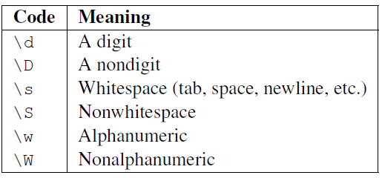
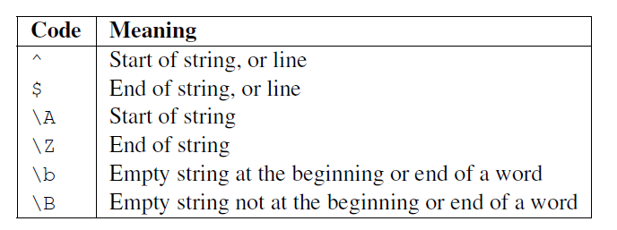
A character set is a group of characters, any one of which can match at that point in the pattern. Eg: [ab] would match either a or b.
Escapes are indicated by prefixing the character with a backslash (\)
Anchoring instructions can be used to match pattern at a specific relative location can be in the input text.
Possible Flags:
re.IGNORECASE
re.MULTILINE
re.VERBOSE

Slide 6
datetime: Date and Time Value Manipulation
Purpose The datetime module includes functions and classes for doing date and time parsing, formatting, and arithmetic.
datetime contains functions and classes for working with dates and times, separately and together.
Calendar date values are represented with the date class. Instances have attributes for year, month, and day. For current date : datetime.date.today()
Timedeltas : Future and past dates can be calculated using basic arithmetic on two datetime objects, or by combining a datetime with a timedelta(stores days, seconds, and microseconds).
Formatting and Parsing: The default string representation of a datetime object uses the ISO-8601 format (YYYY-MM-DDTHH:MM:SS.mmmmmm). Alternate formats can be generated using strftime().
strftime() → Used for formatting a datetime object into required format
strptime() → Parsing a String as a date based on the format passed.
References: http://strftime.org/

Slide 7
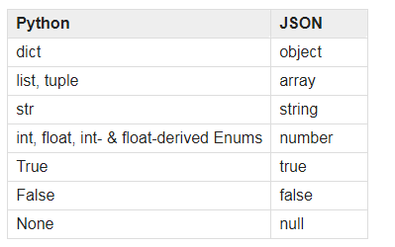
json: JavaScript Object Notation
Purpose Encode Python objects as JSON strings, and decode JSON strings into Python objects.
The json module provides an API to convert in-memory Python objects to a serialized representation known as JavaScript Object Notation (JSON).
The JSON format expects the keys to a dictionary to be strings. Trying to encode a dictionary with nonstring types as keys produces an exception.
load() and dump() accept references to a file-like object to use for reading or writing
loads(): Deserialize a str or bytes or bytearray instance containing a JSON document to a Python object using this conversion table.
dumps(): Serialize obj to a JSON formatted str using this conversion table.

Slide 8
csv: Comma-Separated Value Files
Purpose Read and write comma-separated value files.
The csv module can be used to work with data exported from spreadsheets and databases into text files formatted with fields and records, commonly referred to as comma-separated value (CSV) format because commas are often used to separate the fields in a record.
reader() : each row of the input data is parsed and converted to a list of strings.
writer() : each row of data is iterated over and written row by row.
The DictReader and DictWriter classes translate rows to dictionaries instead of lists. Keys for the dictionary can be passed in or inferred from the first row in the input (when the row contains headers).
Using Custom Delimiter: Registered a dialect using the appropriate delimiter.
eg : csv.register_dialect(’pipes’, delimiter=’|’)

Slide 9
glob: Filename Pattern Matching
Purpose Use UNIX shell rules to find filenames matching a pattern.
It is useful in any situation where a program needs to look for a list of files on the file system with names matching a pattern.
To create a list of filenames that all have a certain extension, prefix, or any common string in the middle, use glob instead of writing custom code to scan the directory contents.
Note: pattern rules for glob are not the same as the regular expressions used by the re module.
An asterisk (*) matches zero or more characters in a segment of a name.
A question mark (?) matches any single character in that position in the name.
Use character range ([a-z]) instead of a question mark to match one of several characters.

Slide 10
shutil: High-Level File Operations
Purpose High-level file operations like copying and setting permissions.
copy() : Copies the file src to the file or directory dst. src and dst should be strings. If dst specifies a directory, the file will be copied into dst using the base filename from src. Returns the path to the newly created file.
move() : Recursively move a file or directory (src) to another location (dst) and return the destination.
Note: OSError exception will be raised if destination location is not writable due to permission issues.
Misc Functions : disk_usage, chown, copytree , rmtree,
Reference: https://docs.python.org/3.6/library/shutil.html
Note: Not all functions in this module are Windows friendly

Slide 11
filecmp: Compare Files
Purpose Compare files and directories on the file system.
filecmp module includes functions and a class for comparing files and directories on the file system.
cmp() compares two files on the file system. shallow argument tells cmp() whether to look at the contents of the file, in addition to its metadata. By default cmp does shallow comparison.
i.e : Files of the same size created at the same time are reported as the same, and their contents are not compared.
For recursive comparison of large directory trees or for more complete analysis, the dircmp() is more useful. This function call is chained with report() and it prints a report comparing two directories.

Slide 12
zipfile: ZIP Archive Access
Purpose Read and write ZIP archive files.
The zipfile module can be used to manipulate ZIP archive files.
The is_zipfile() function returns a Boolean indicating whether or not the filename passed as an argument refers to a valid ZIP archive
Operations:
Creating New Archives
Extracting Archived Files from an Archive
Appending to Files
Note : zipfile module does not support ZIP files with appended comments or multidisk archives. It does support ZIP files larger than 4 GB that use the ZIP64 extensions.

Slide 13
tarfile: Tar Archive Access
Purpose Read and write tar archives.
The tarfile module provides read and write access to UNIX tar archives, including compressed files.
Although tarfile implements a UNIX format, it can be used to create and read tar archives under Microsoft Windows, too.
is_tarfile() function returns a Boolean indicating whether or not the filename passed as an argument refers to a valid tar archive
To unpack the archive and write the files to the file system, use extract() or extractall() function.
Refer : http://docs.python.org/library/tarfile.html

Slide 14
getpass: Secure Password Prompt
Purpose Prompt the user for a value, usually a password, without echoing what is typed to the console.
The getpass module provides a portable way to handle such password prompts securely.
Usage:
Handling Secret Keys
Handling Password Stings
Reference : http://docs.python.org/library/getpass.html

Slide 15
sys: System-Specific Configuration
Purpose Provides access to low level system-specific configuration and operations.
Passing Comand Line Arguments:
sys.argv: The list of command line arguments passed to a Python script. argv[0] is the script name.
Interpreter executable: sys.executable
Installation prefix : sys.prefix
Error out stream →sys.stderr Input stream → sys.stdin Output stream → sys.stdout
Recursion Limit:
Initial limit:, sys.getrecursionlimit()
sys.setrecursionlimit(10)
System Paths that are listed : sys.path (When we import module, python looks for the packages in these locations)
Use sys.path.insert(0, ‘filename’) : To Add Particular directory to path

Slide 16
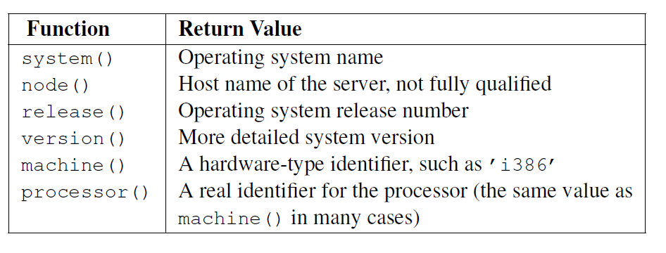
platform: System Version Information
Purpose Probe the underlying platform’s hardware, operating system, and interpreter version information.
The platform module includes the tools for learning about the interpreter, operating system, and hardware platform where a program is running.
Version : platform.python_version()
Compiler : platform.python_compiler()
Build : platform.python_build()

Slide 17
os: Portable Access to Operating System Specific Features
os.environ : A mapping object representing the string environment. (Accessing Environment Variables)
os.getcwd() : Returns the current working directory where the code is executed.
os.uname() Returns information identifying the current operating system. The return value is an object with five attributes:
sysname - operating system name
nodename - name of machine on network (implementation-defined)
release - operating system release
version - operating system version
machine - hardware identifier

Slide 18
os: Portable Access to Operating System Specific Features
os.mkdir : Create a directory named path with numeric mode mode. If the directory already exists, FileExistsError is raised.
os.remove : Remove (delete) the file path. If path is a directory, OSError is raised.
os.rename(src, dst) Rename the file or directory src to dst. If dst is a directory, OSError will be raised.
os.rmdir() : Remove (delete) the directory path. Only works when the directory is empty, otherwise, OSError is raised. In order to remove whole directory trees, shutil.rmtree() can be used.
os.kill(pid, sig) Send signal sig to the process pid.
os.popen : The return value is an open file object connected to the pipe, which can be read or written depending on whether mode is 'r' (default) or 'w'.

Slide 19
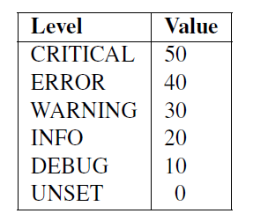
logging: Report Status, Error, and Informational Messages
Purpose Report status, error, and informational messages.
The logging module defines a standard API for reporting errors and status information from applications and libraries.
Logging to a File
Use the basicConfig() function to set up the default handler so that debug messages are written to a file.
Rotating Log Files :
RotatingFileHandler, can be used to create new files automatically and preserves the old log file at the same time
Verbosity Levels : Produce different messages at different log levels.

Slide 20
random: Pseudorandom Number Generators
Purpose Implements several types of pseudorandom number generators.
random(): function returns the next random floating-point value from the generated sequence. All return values fall within the range 0 <= n < 1.0
randint() : generate integers directly . Takes the lowest and highest value as parameters both included
randrange(): Selecting values from a range. Takes three arguments(start, stop, step). It is more efficient, because the range is not actually constructed.
Choice() function for making a random selection from a sequence.
Generating values with a normal distribution, normalvariate() and the slightly faster gauss().

Slide 21
pdb: Interactive Debugger
Purpose Python has an interactive debugger.
It includes features to pause a program, look at the values of variables, and watch program execution step by step, so you can understand what the program actually does and find bugs in the logic.
Starting the Debugger
From the Command Line : python -m pdb pdb_script.py
Within the Interpreter : import pdb followed by pdb.set_trace() at location where you want to start the debugger
%%debug can be used in Jupyter Notebook to start pdb interpreter. It Automatically points at the location where the last error was raised
Commands: help(h), step(s), continue, p(i.e print) ,quit (q),return(r)

